Slide 1
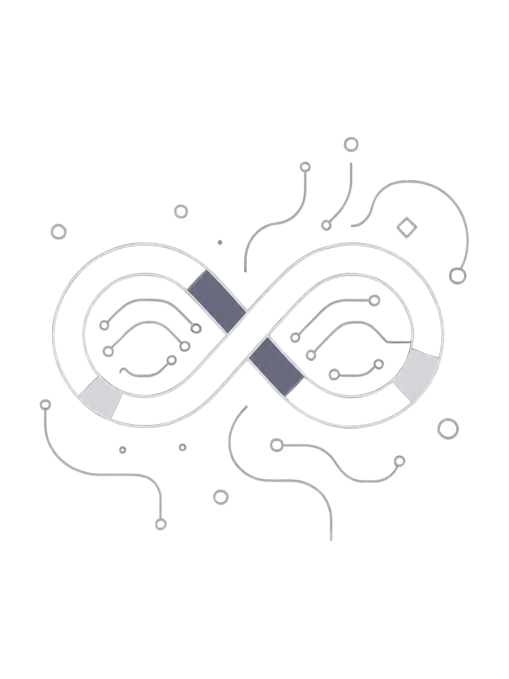
Loop Engineering
Modern AI agents don't just respond — they iterate. Loop Engineering is the discipline of designing systems that Reason → Act → Observe → Repeat until a goal is achieved, moving beyond one-shot execution to adaptive, production-grade intelligence.

Slide 2
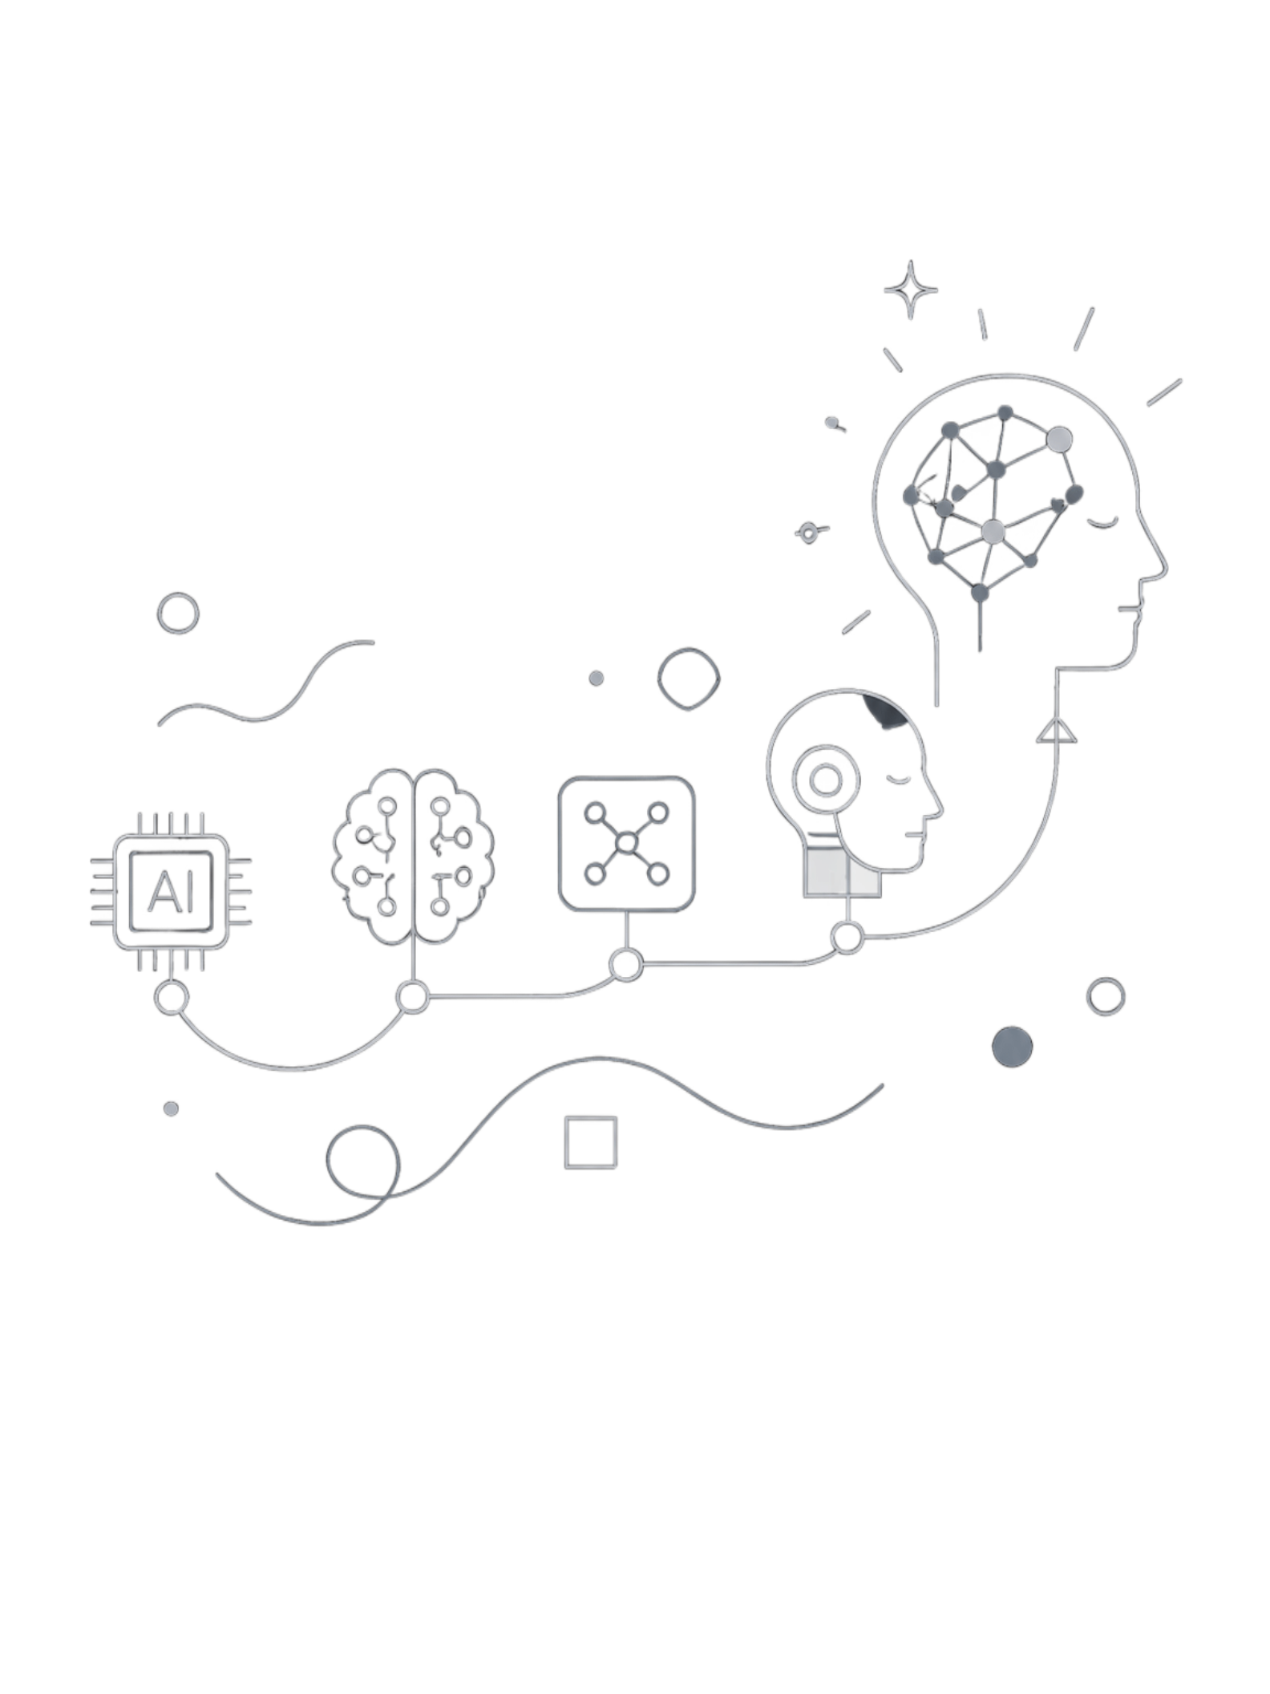

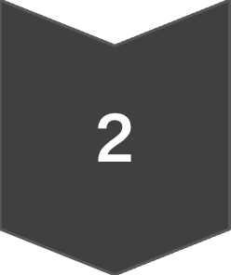
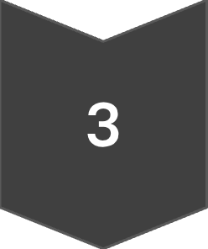
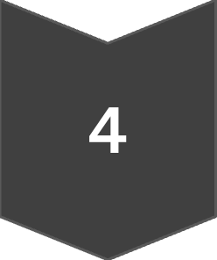
Why Is Everyone Talking About It?
Leaders like Peter Steinberger (OpenAI) and Boris Cherny (Anthropic) signal a fundamental shift: AI products are no longer just chatbots — they're becoming agents. The engineering discipline has evolved through four distinct phases:
Prompt Engineering
Context Engineering
Agent Engineering
Loop Engineering

Slide 3


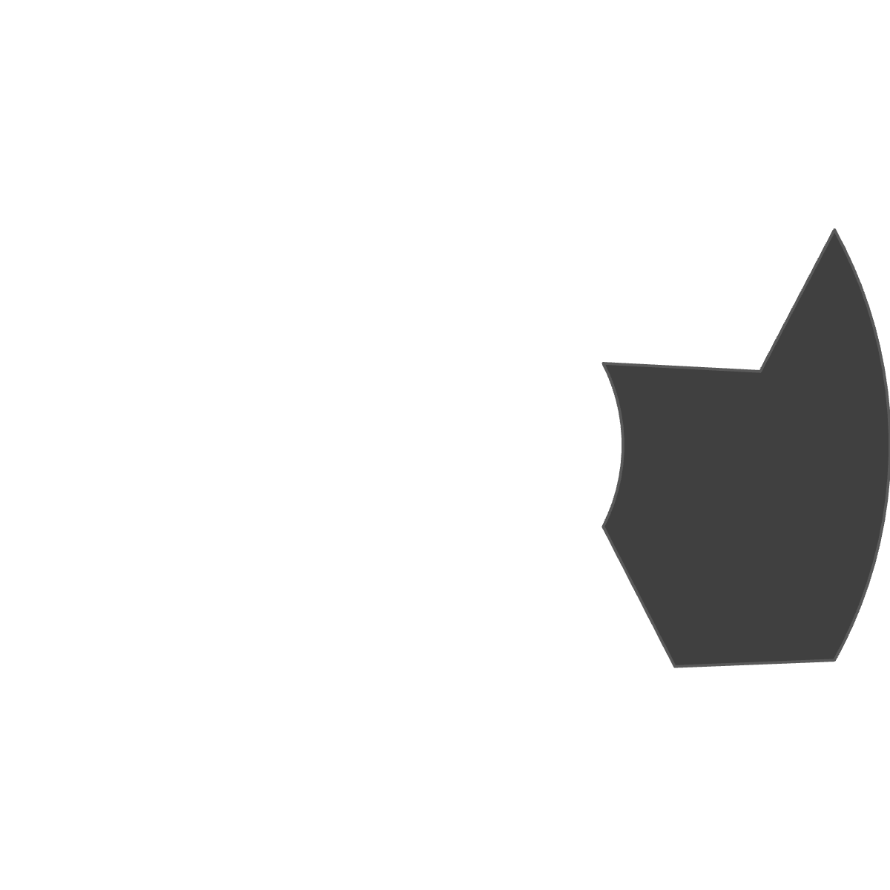


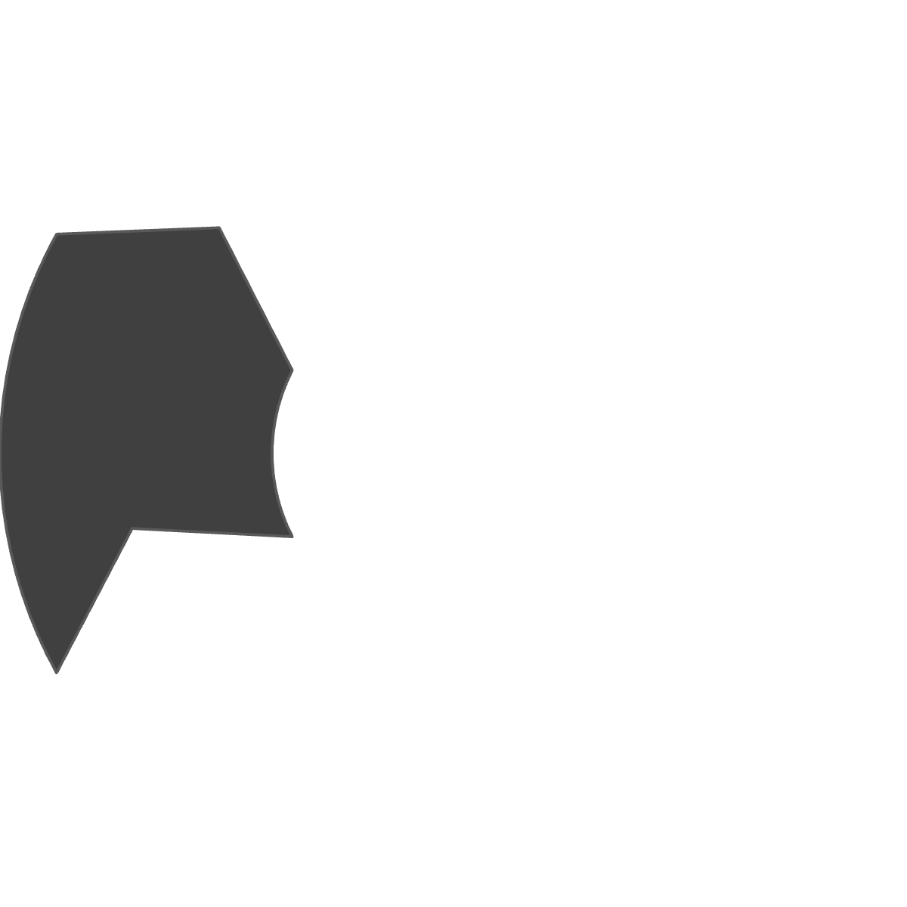






How Does a Loop Work?
Every loop follows a conceptual lifecycle — from first discovery to final reflection. This is what happens during execution:
Discover
Plan
Identify the problem space
Devise a strategy
Repeat
Execute
Iterate until goal is met
Take action
Reflect
Observe
Evaluate and adapt
Measure the outcome
Production systems require much more than a simple loop.

Slide 4
Building Blocks of a Production Loop
Addy Osmani's six primitives transform conceptual loops into production-ready systems:
Automations
Worktrees
Trigger recurring work
Isolated workspaces per agent, sharing repo history for true parallel execution
Skills
Plugins / MCP
Reusable knowledge
Tool integration
Sub-agents
Persistent Memory
Specialized responsibilities
Long-term state

Slide 5



What Makes a Good Loop?
Design Decisions
Key Metrics
Should I retry? Stop? Ask another agent?
Should I verify? Use another tool?
What should I remember?
Success Rate
Cost & Latency
Iterations
Tool Success Rate
Many production agents complete tasks in approximately 3–10 iterations. Frameworks expose configurable iteration limits to balance accuracy, latency, and cost.
Recovery Rate

Slide 6
Framework Support
Frameworks help implement production loops with varying capabilities:
Feature
LangGraph
OpenAI Agents SDK
AutoGen
Durable Execution
Durable execution
✅
Partial
Partial
✅
Checkpoints
✅
Trace-based
Partial
—
Tool calling
✅
✅
✅
—
Human approval
✅
Partial
Partial
—
State
✅
Session
Agent memory
—
"The art of loop engineering is designing how an agent iteratively plans, executes, evaluates, and adapts — not simply prompting it." — LangChain

Slide 7
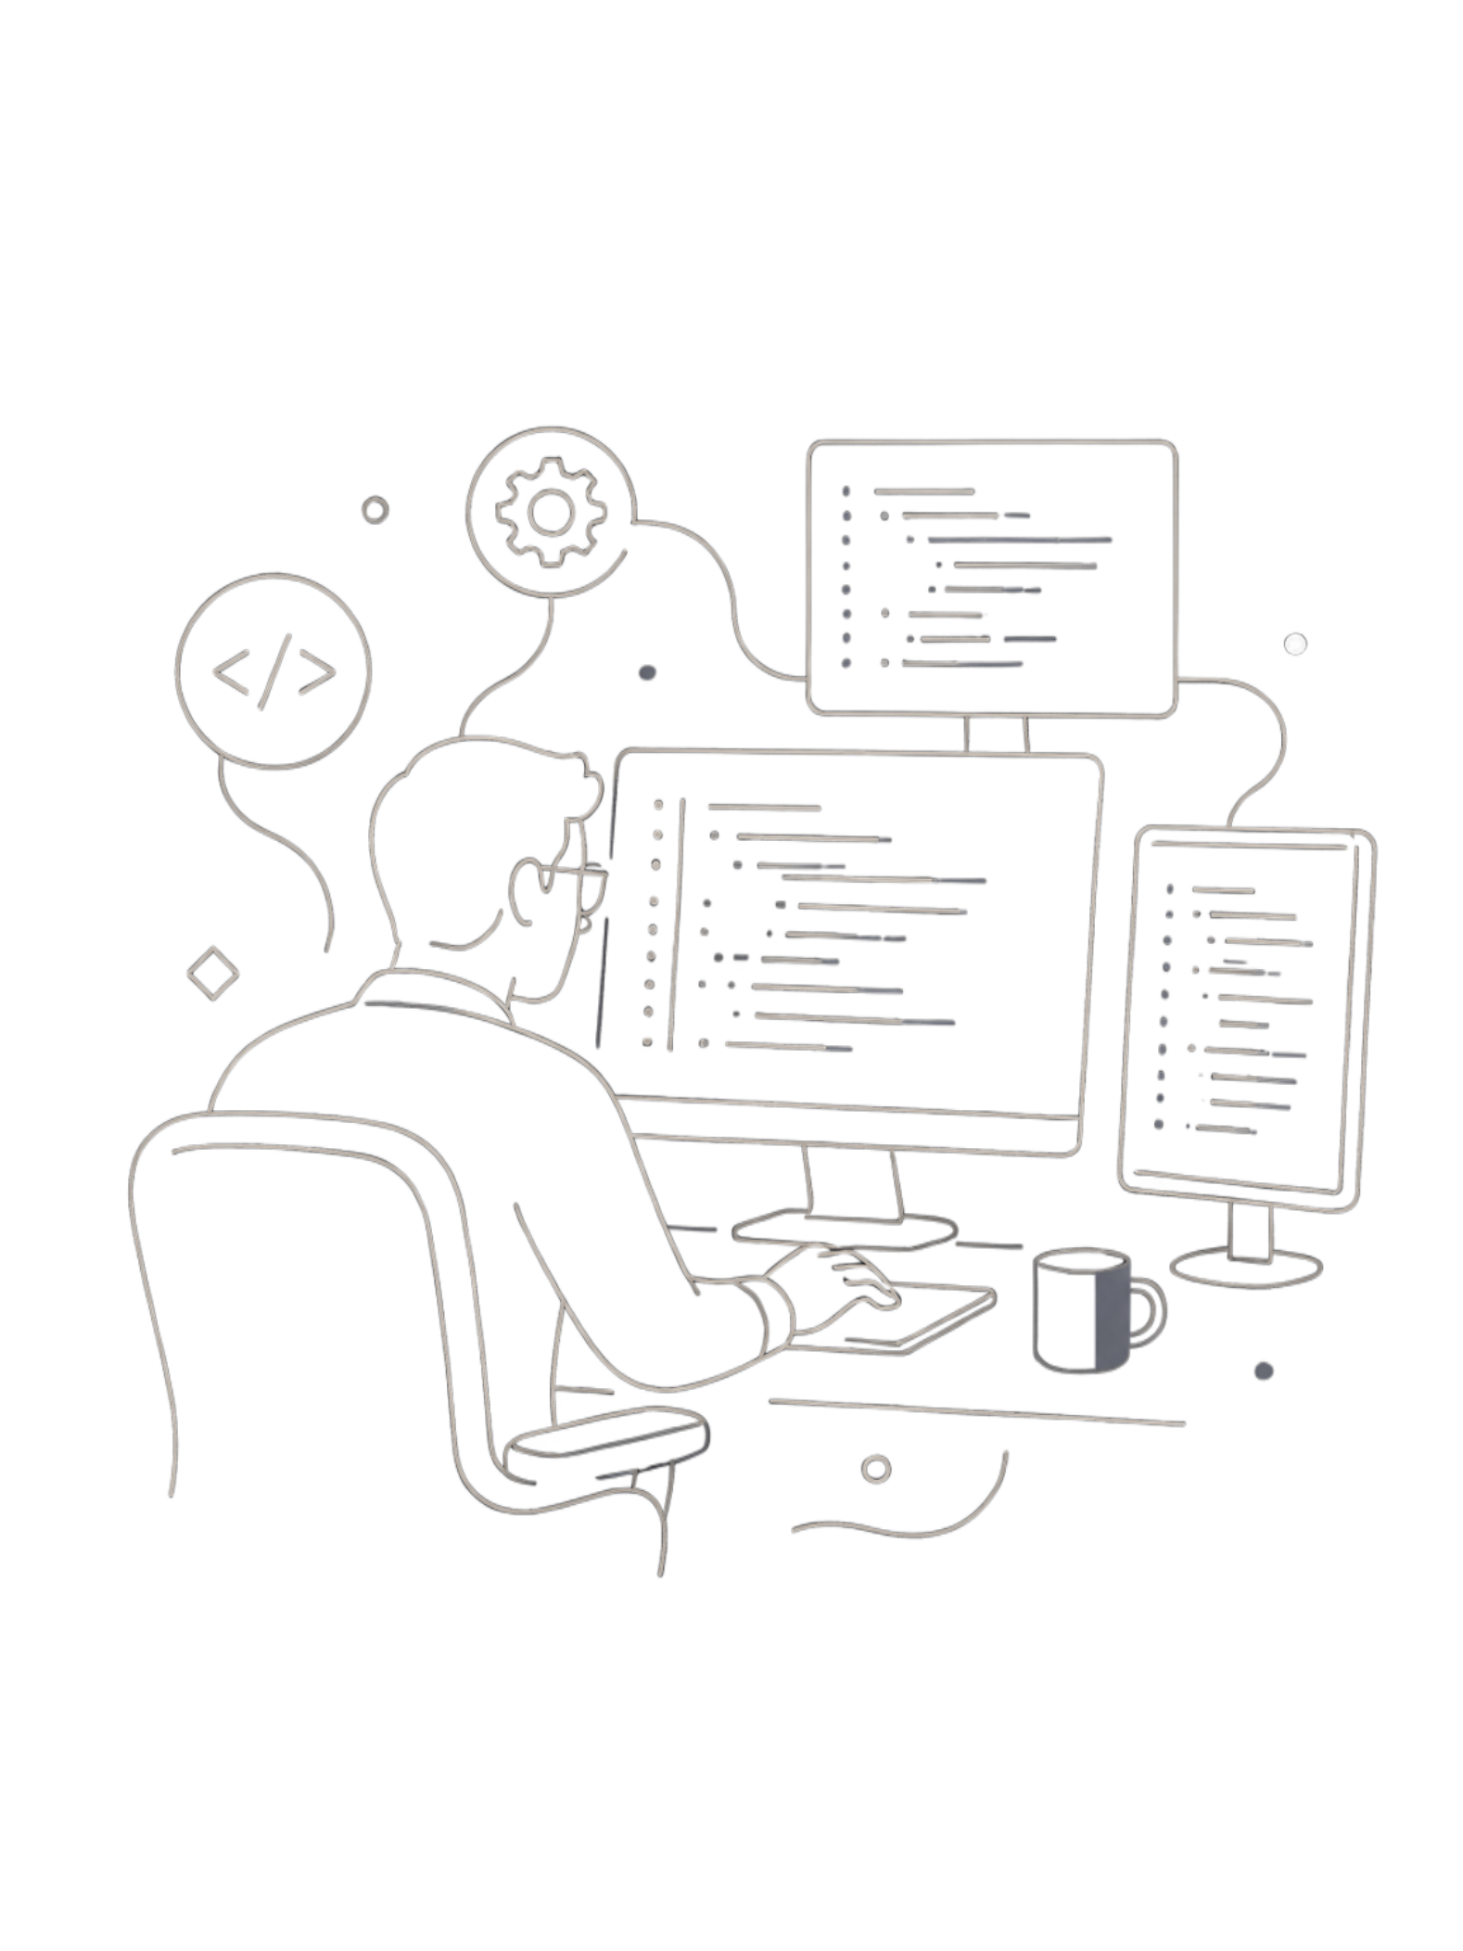


Real-World Applications
Loop engineering powers autonomous systems across industries — each follows a Problem → Loop → Outcome pattern.
🛠 Software Development
Problem: One prompt cannot reliably fix a bug.
Loop: Analyze → Modify → Test → Observe → Retry
Outcome: Autonomous debugging.
🎧 Customer Support
Problem: Refunds require verification.
Loop: Read account → Check purchase → Verify policy → Execute refund
Outcome: Policy-compliant automation.

Slide 8

Real-World Applications (cont.)
🔬 Research Assistant
🔐 Cybersecurity
Problem: One search rarely finds sufficient evidence.
Loop: Search → Read → Compare → Search again
Outcome: Evidence-backed synthesis.
Problem: One alert isn't enough.
Loop: Collect logs → Correlate → Investigate → Escalate
Outcome: Faster incident response.

Slide 9
Challenges & Best Practices
Key Challenges
Best Practices
Infinite Loops: Always set iteration limits.
Cost Control: Track token usage per iteration.
Observability: Log every step for debugging.
State Management: Persist context across failures.
Human Oversight: Add approval gates for critical actions.
Define clear exit conditions.
Implement retry logic with backoff.
Use structured outputs for reliability.
Monitor success rate, cost, and latency.
Design for graceful degradation.

Slide 10

Key Takeaways
Loops Are the New Architecture
Agents that iterate outperform one-shot systems.
Design for Production
Worktrees, persistent memory, and sub-agents are essential primitives.
Measure Everything
Track success rate, cost, latency, and iterations.
Choose the Right Framework
LangGraph, OpenAI Agents SDK, and AutoGen each offer different trade-offs.
Loop Engineering isn't just a trend — it's the foundation of reliable, autonomous AI systems.

